Slide 1
Computing Subject Group Course Talks
Foundation Computing
HNC Data Analyst HNC Cyber-Security Technologist HNC Network Engineer BSc (Hons) Computing BSc (Hons) Software Engineering BSc (Hons) Cyber Security Management BSc (Hons) Computer Systems & Network Engineering
UPDATED 14 April 2023

Slide 2
Content
01 | Admissions
02 | Teaching and Learning
03 | Employability
04 | Contact & Delivery
05 | Courses
06 | Professional Certification 07 | Placement Year
08 | Student Experience
09 | Graduate Destinations
10 | Further Guidance

Slide 3
01 | Admissions

Slide 4
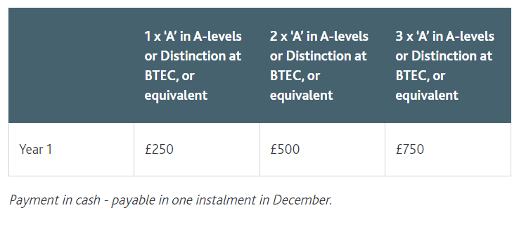
01 | Admissions
Academic Merit Scholarship
Be rewarded for excellence
Scholarships for undergraduate, postgraduate, international, BAME, direct entrants, etc.
Example: Undergraduate Academic Merit Scholarship
Scholarships and Bursaries
solent.ac.uk/finance/grants-bursaries-scholarships/scholarships

Slide 5
02 | Teaching and Learning

Slide 6

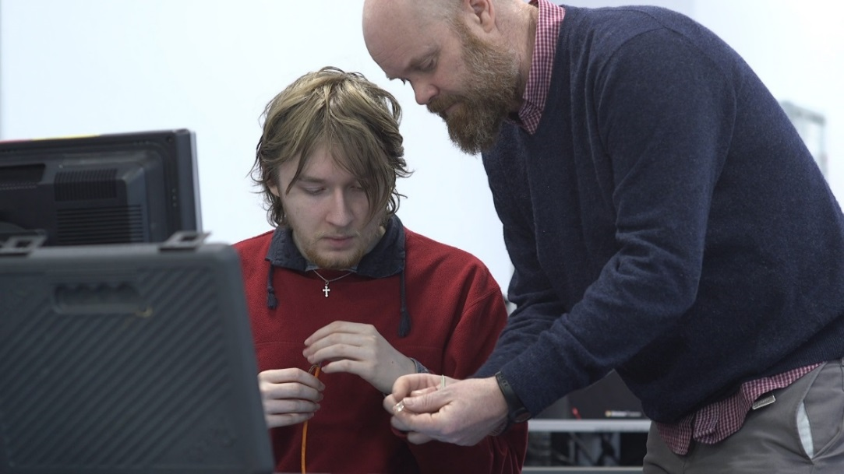
Our Teaching & Learning Approaches
Staff are highly qualified both academically & professionally including cisco certified trainers.
Most of the teaching takes place in small groups in Computer labs to get hands-on practical skills.
Teaching in small groups allows ample of opportunities to get individual support
Student-centric problem-based active-learning methods
Assessment methods include mini projects, practical tests, technical reports, group assignments, & presentations - no formal exam
Notes:
Martin R Delivery

Slide 7
03 | Employability

Slide 8
“As demand for digital skills outstrips supply […] (particularly in high level roles such as developers).”
(HM GOVERNMENT 2016, p3)
DIGITAL SKILLS for the UK ECONOMY https://assets.publishing.service.gov.uk/government/uploads/system/uploads/attachment_data/file/492889/DCMSDigitalSkillsReportJan2016.pdf

Slide 9
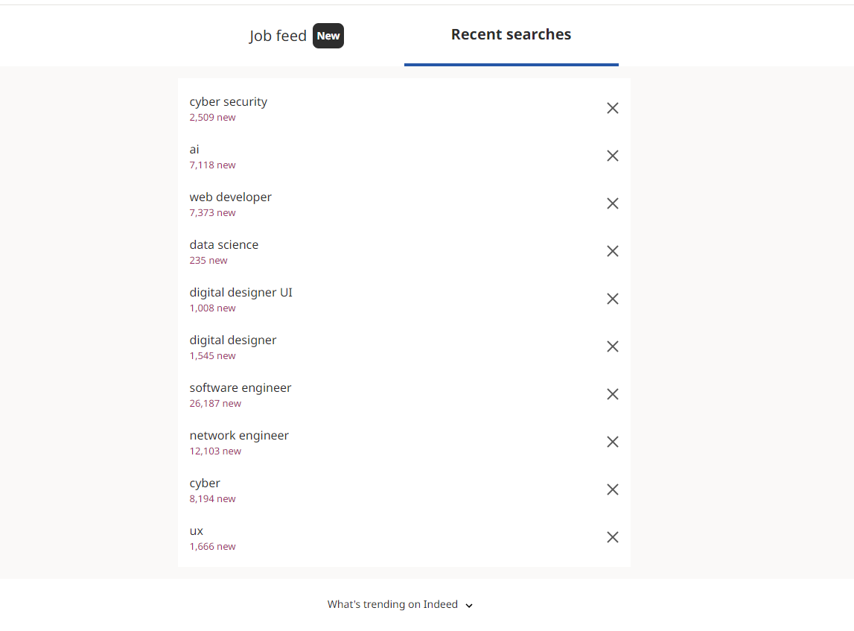
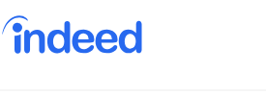
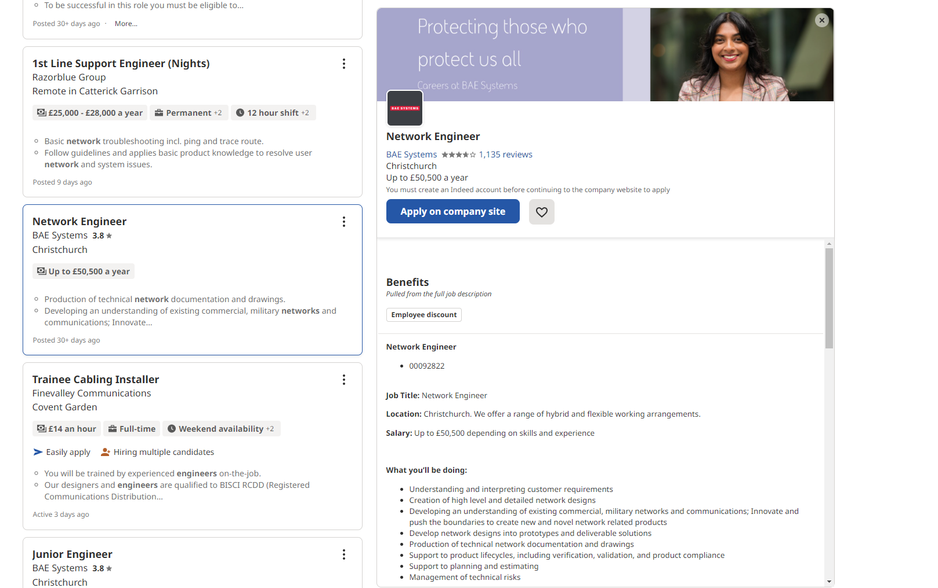
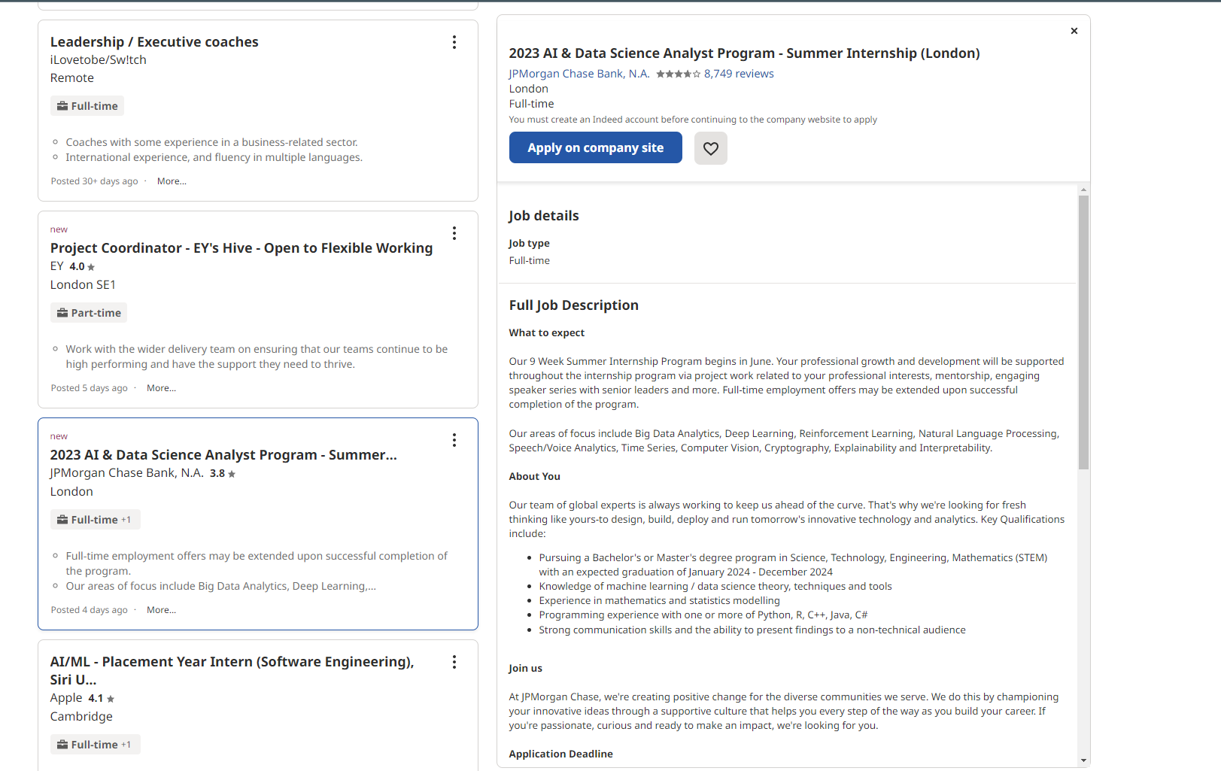
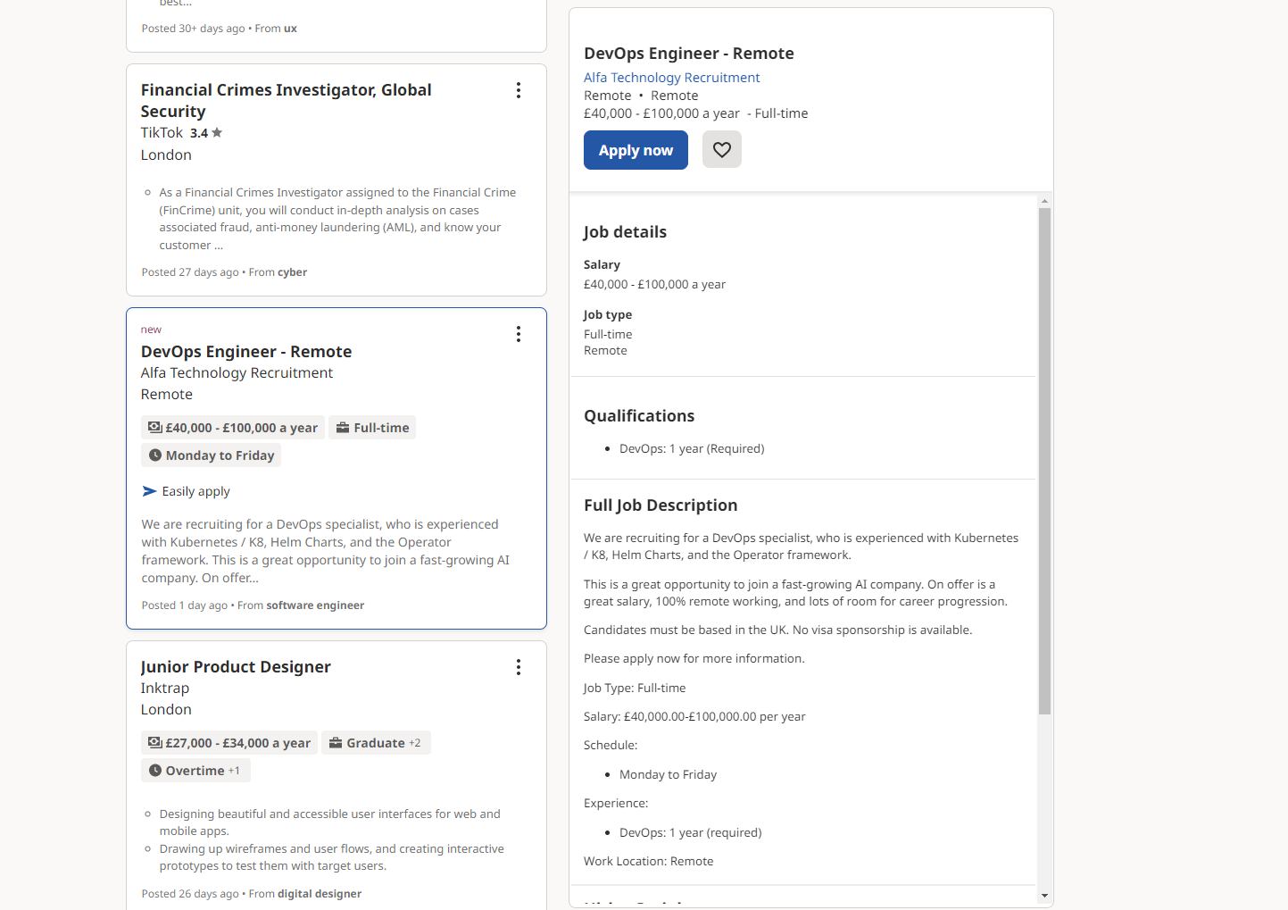
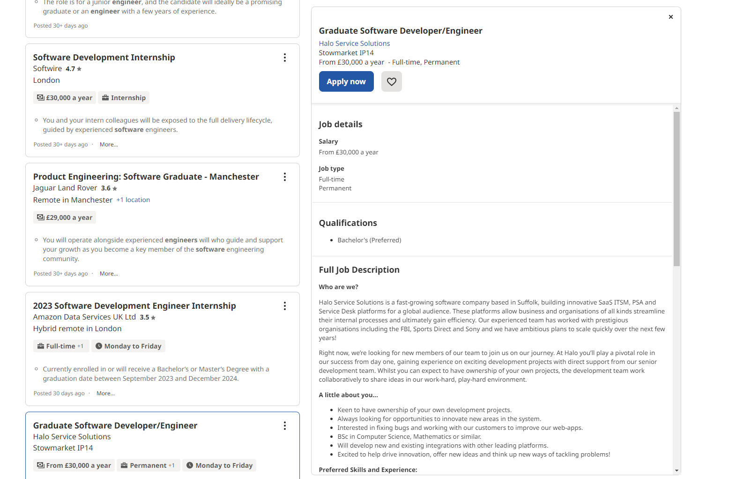
“As demand for digital skills outstrips supply […] (particularly in high level roles such as developers).”
(HM GOVERNMENT 2016, p3)
DIGITAL SKILLS for the UK ECONOMY https://assets.publishing.service.gov.uk/government/uploads/system/uploads/attachment_data/file/492889/DCMSDigitalSkillsReportJan2016.pdf
Notes:
Martin R Delivery

Slide 10


There were over 2 million vacancies for tech roles between May 2021 and 2022, from a total 14.85 million vacancies across the economy as a whole.
Growth in number of advertised job vacancies by proportion of tech vacancies
Job Title | 2022 Vacancies | Proportion Vacancies | 2019 Vacancies | Growth since 2019
Business Analyst | 26067 | 3.71% | 3479 | 7.5
Data Analyst | 12432 | 1.77% | 2004 | 6.2
Product Manager | 11981 | 1.70% | 1479 | 8.1
Data Engineer | 9568 | 1.36% | 2148 | 4.5
Product Owner | 5243 | 0.75% | 852 | 6.2
Nearly 5 million people now work in the digital tech economy, up from 2.18 million in 2011
On average, tech salaries are nearly 80% higher than salaries for non tech jobs in the UK, at £62,000 compared to £35,000 as of Q1 2022
TECHNATION.IO., 2022. People and skills report 2022 - Tech Nation [viewed 19 March 2023]. Available from: https://technation.io/people-and-skills-report-2022/#key-statistics
TECHNATION.IO., 2022. People and skills report 2022 - Tech Nation [viewed 19 March 2023]. Available from: https://technation.io/people-and-skills-report-2022/#key-statistics
Notes:
Martin R Delivery

Slide 11











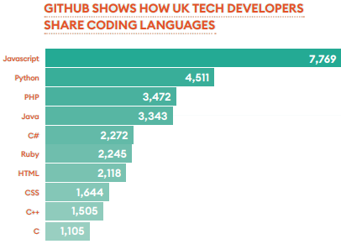















05 | Employability
Skills, technologies and opportunities
We cover the major technologies and skills and provide opportunities to help our students develop.
SOLENT PLACEMENT AND GRADUATE FAIR ​
FREE LINKEDIN PHOTO BOOTH
MEET OVER 70
EMPLOYERS
CV CHECKS
BY EMPLOYERS

Slide 12
04 | Contact & Delivery

Slide 13

04 | Delivery & Contact Time
2x Semesters (Sept- Jan & Jan-May) 12 weeks of teaching plus assessment weeks
3x Modules each Semester Teaching contact time 12 hours per week (approx.)

Slide 14
05 | Courses

Slide 15
05 | Our Courses
Foundation Computing (Level 3) HNC Data Analyst (Level 4) HNC Cyber-Security Technologist (Level 4) HNC Network Engineer (Level 4) BSc (Hons) Computing BSc (Hons) Software Engineering BSc (Hons) Cyber Security Management BSc (Hons) Computer Systems & Network Engineering

Slide 16
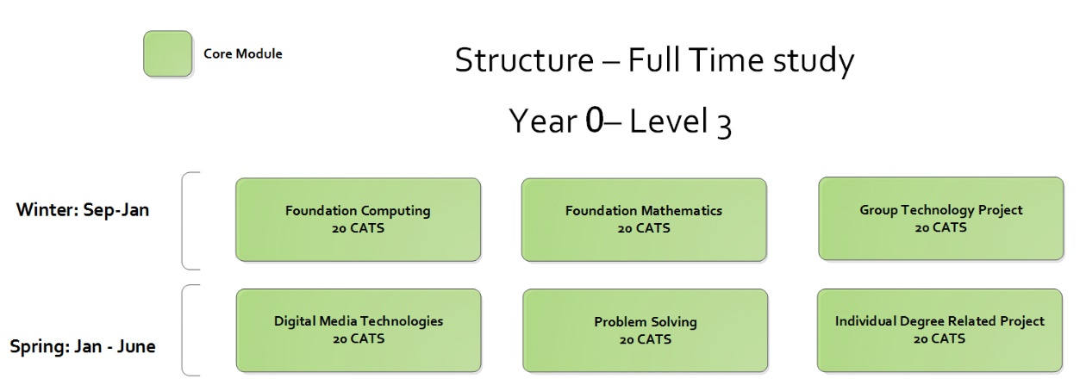
05 | Our Courses - Foundation Computing
UCAS points: 48

Slide 17
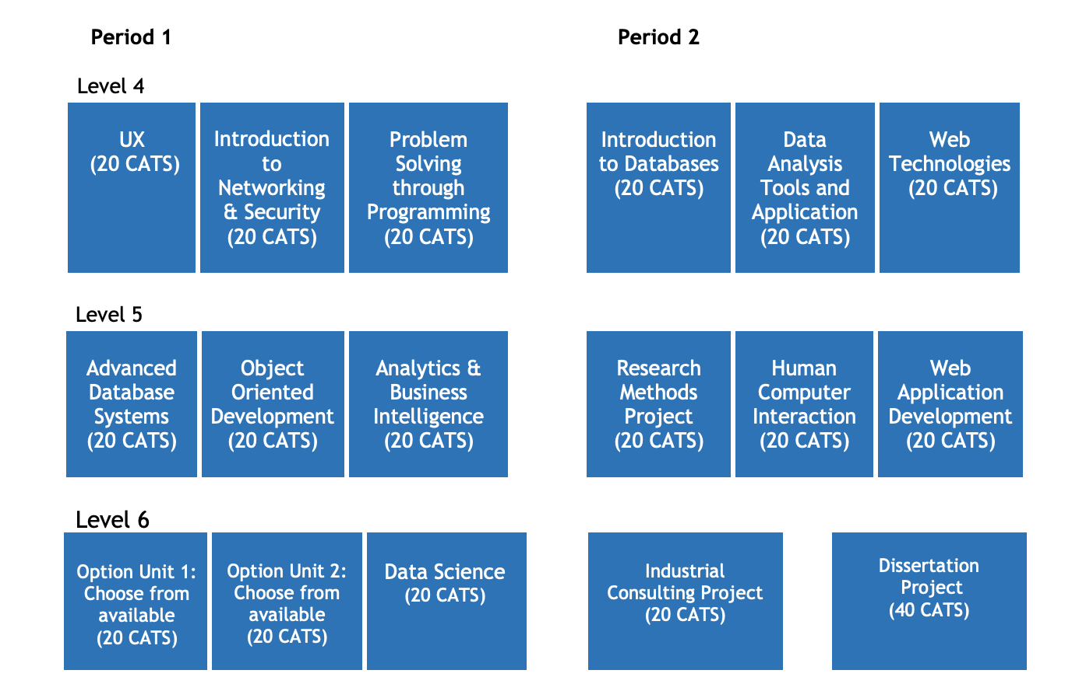
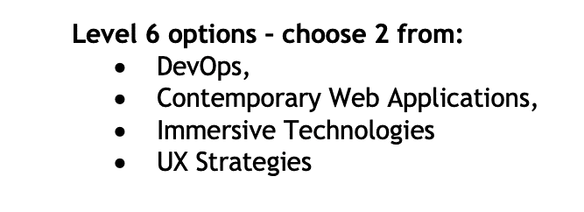
05 | Our Courses - Computing
UCAS points:112-128
solent.ac.uk/courses/undergraduate/computing-bsc

Slide 18
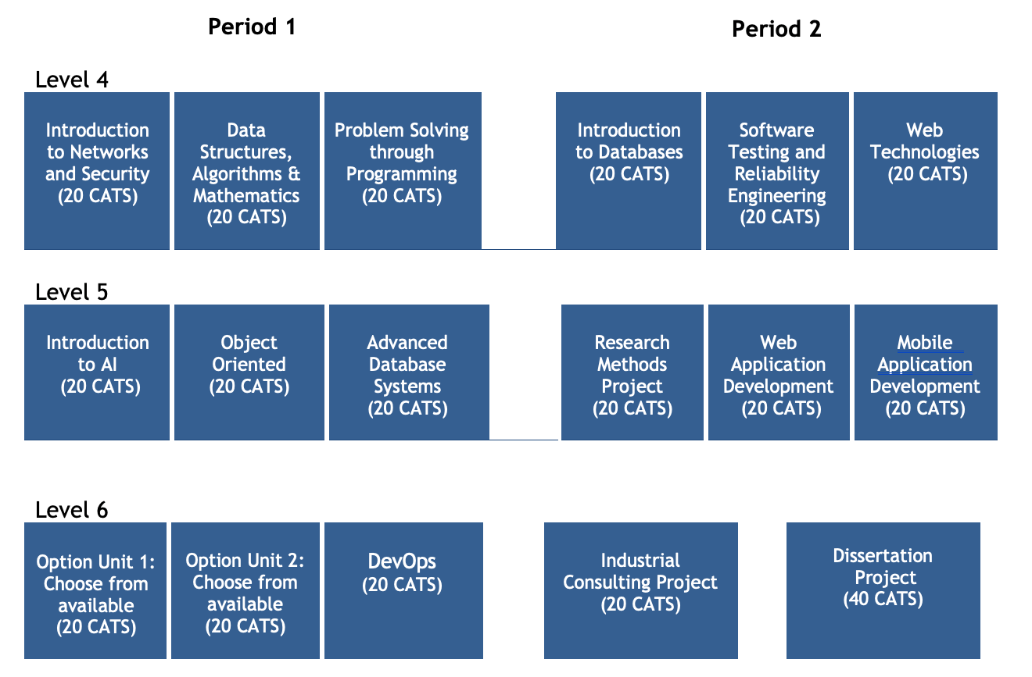

05 | Our Courses - Software Engineering
UCAS points:112-128
solent.ac.uk/courses/undergraduate/software-engineering-bsc

Slide 19
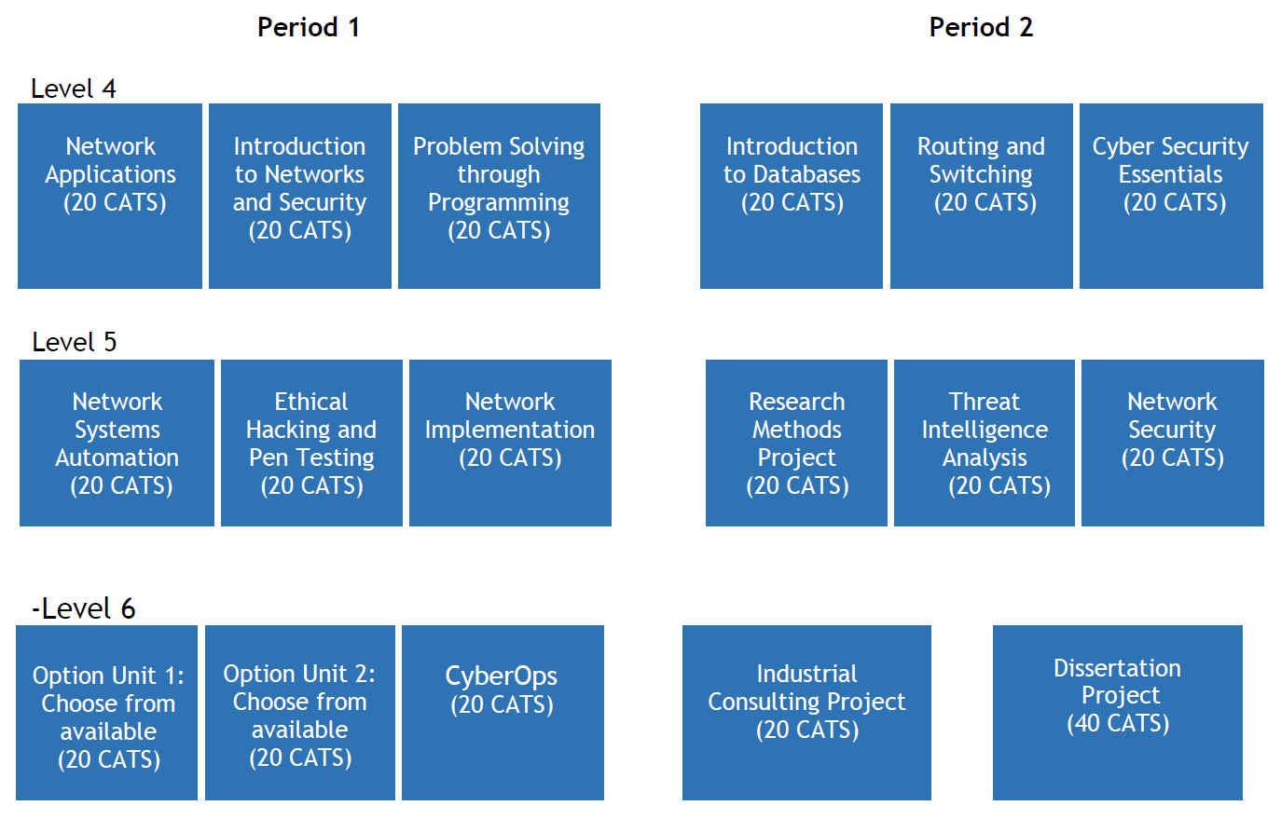
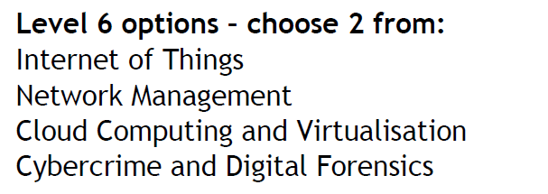
05 | Our Courses - Cyber Security Management
UCAS points:104-120
solent.ac.uk/courses/undergraduate/cyber-security-management-bsc

Slide 20
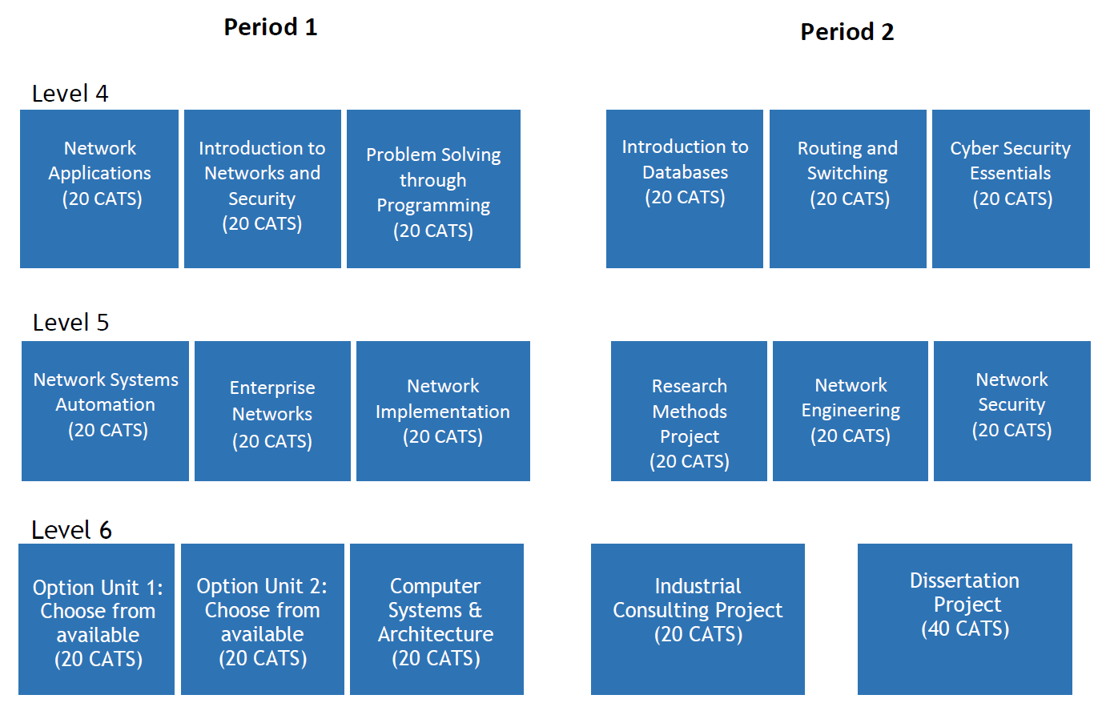
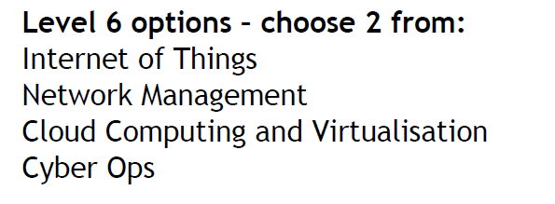
05 | Our Courses - Computer Systems & Network Eng
UCAS points:104-120
solent.ac.uk/courses/undergraduate/computer-systems-and-networks-engineering-bsc

Slide 21
06 | Professional Certification

Slide 22




Employability Perspectives
A practical course providing in-depth knowledge and understanding of underlying principles and the technical skills needed by the industry.
Research-led and Industry-led curriculum.
Cisco Networking Academy, EC-Council, and recently Partner with Juniper Networks.
Embedded professional qualification, CCNA-RS, CCNA-Security, CEH.
Notes:
Shakeel Delivery

Slide 23
07 | Placement Year

Slide 24

Placements (Year in Industry)
Option available to take placement between the 2nd & 3rd years for undergraduate & at the end of study for postgraduate.
Solent Futures dedicated to providing support, resources and guidance
Courses offering placement: BSc (Hons) Computing BSc (Hons) Software Engineering BSc (Hons) Cyber Security Management BSc (Hons) Computer Systems & Network Engineering
MSc Computer Engineering MSc Cyber Security Engineering MSc Applied AI & Data Science
Notes:
Martin R Delivery

Slide 25
08 | Student Experience

Slide 26
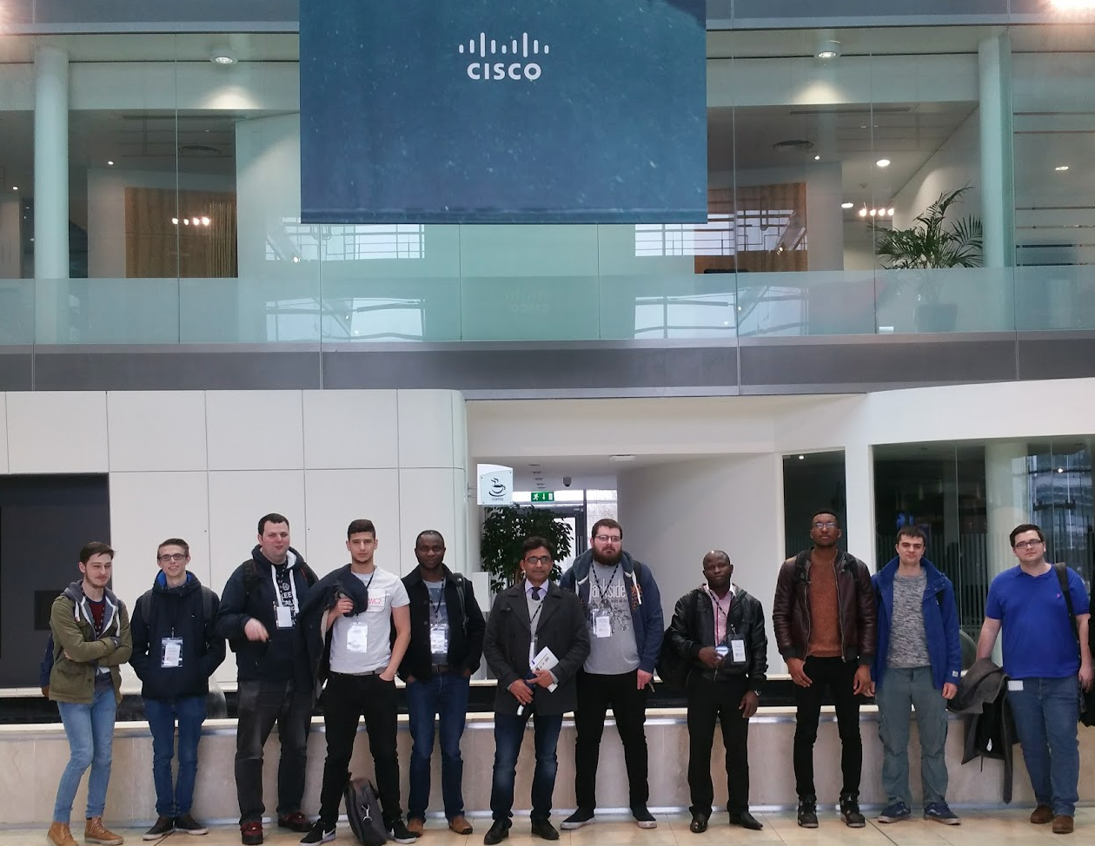
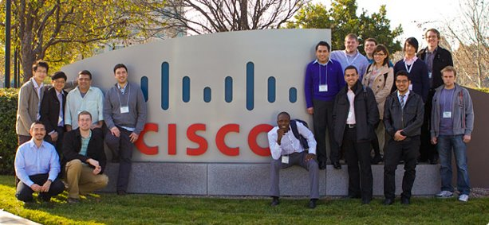
Beyond Curriculum
Placement: A fantastic opportunity to gain work experience in the industry – learn and earn
Our students have done or currently doing placements at big names, like, Airbus, Cisco, Juniper and IBM.
Students also benefit from industry visits, hackathons, guests-speakers from Industry, and Job-fairs.
Notes:
Shakeel Delivery

Slide 27

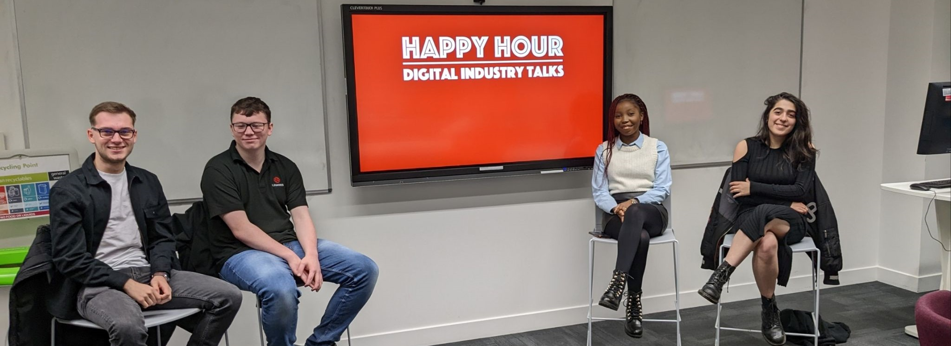
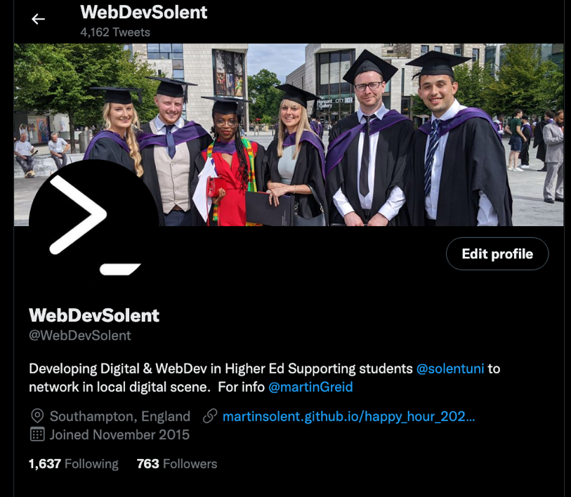
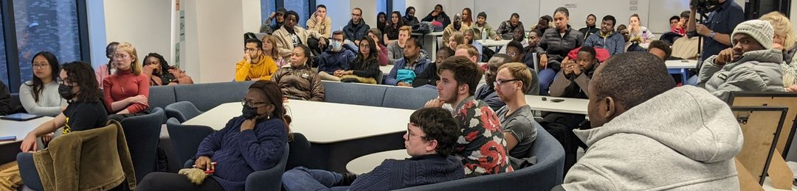
https://twitter.com/WebDevSolent
Notes:
Martin R Delivery

Slide 28
09 | Graduate Destinations

Slide 29
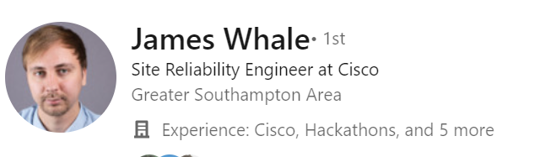

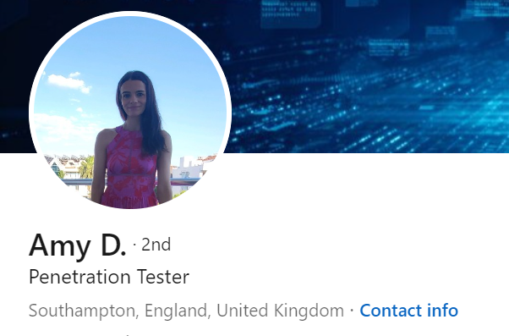
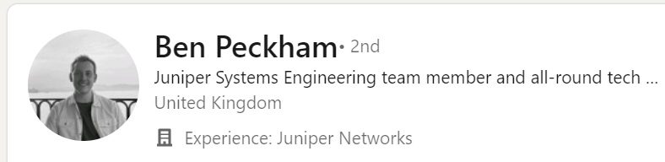

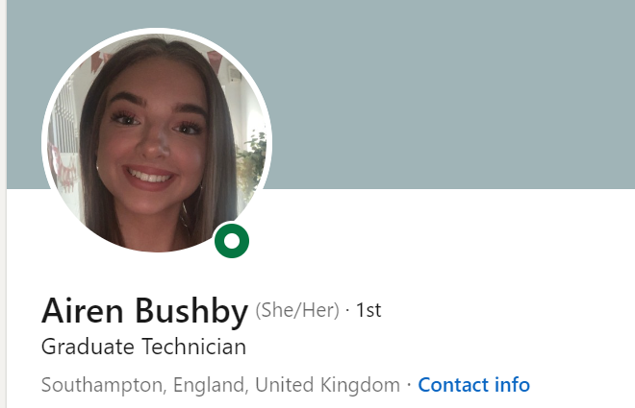
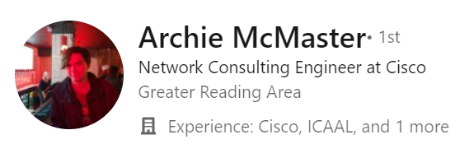
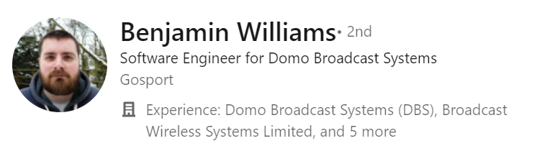
Alumni Network on Linkedin
We have a strong Alumni community working at well-known tech companies including Juniper, Cisco, normcyber, Utilita Energy, Domo Broadcast Systems, Edifit, Gamban, Amazaon AWS, NRC Corporate,
Notes:
Shakeel Delivery

Slide 30


Success Stories
Ben Peckham, a graduate cyber security Management (2020)
“From a technical perspective, everything I needed for a post-grad position was provided through my course. I remember, during my first interview with Juniper, sitting in front of a whiteboard and being asked how I would design a campus network, and we had recently covered this in a lecture. Plus, presentations to the rest of my class really helped as I now present in front of customers.” https://www.solent.ac.uk/solent-stories/computing/ben-peckham
Students won first place in the Royal Hackaway Hackathon (2021) https://www.solent.ac.uk/news/solent-students-win-first-place-at-royal-hackaway
Notes:
Shakeel Delivery

Slide 31

Graduate Destinations
L3Harris Technologies Clevertouch Marketing VaynerMedia Bold Insight UK Adidas Utilita Energy Ocean Infinity JP Morgan Chase Fresh Relevance Monzo Hampshire County Council PlayPal Spyrosoft Blue Frontier IBM Ordnance Survey Virgin Media O2 Dyson Steadfast Collective McKenzie Intelligence Services Ltd Pulselive - A Sony Sports Company Pulselive
Derived from LinkedIn search of computing subject group graduates 24/3/023
Notes:
Martin R Delivery

Slide 32
10 | Further Guidance

Slide 33

https://qa.solent.ac.uk/centres/courses/bsc-hons-computing-with-foundation-year/

Slide 34
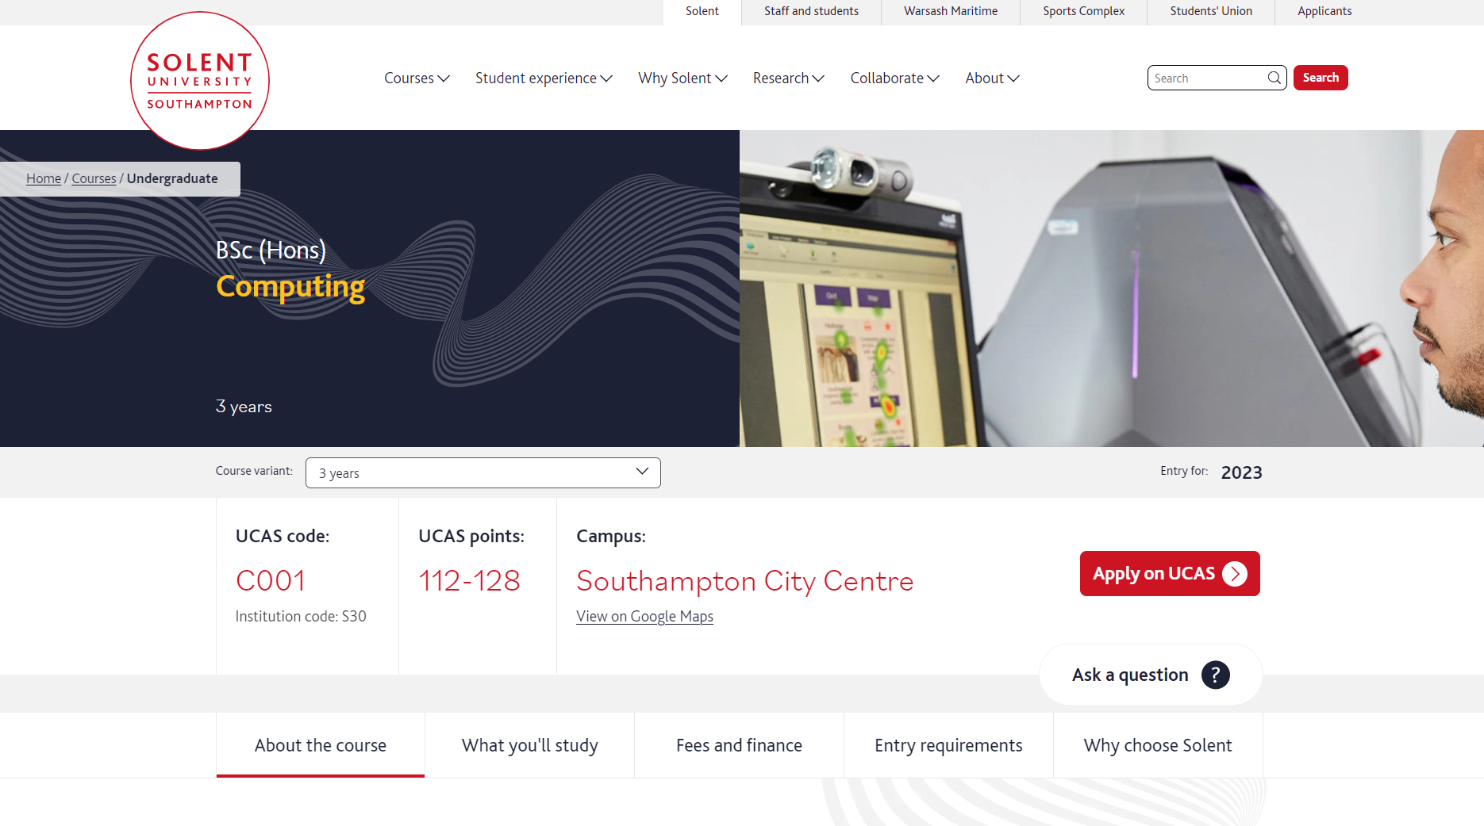
https://www.solent.ac.uk/courses/undergraduate/computing-bsc

Slide 35
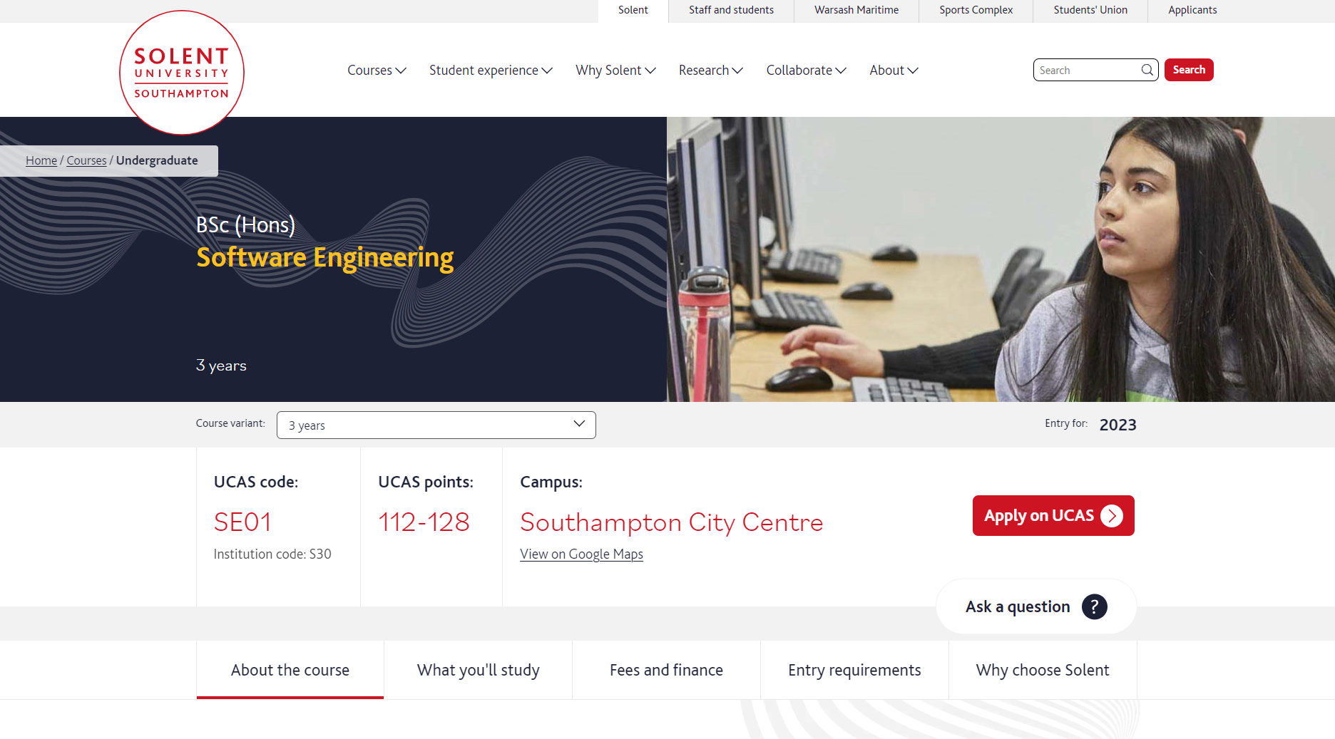
https://www.solent.ac.uk/courses/undergraduate/software-engineering-bsc

Slide 36
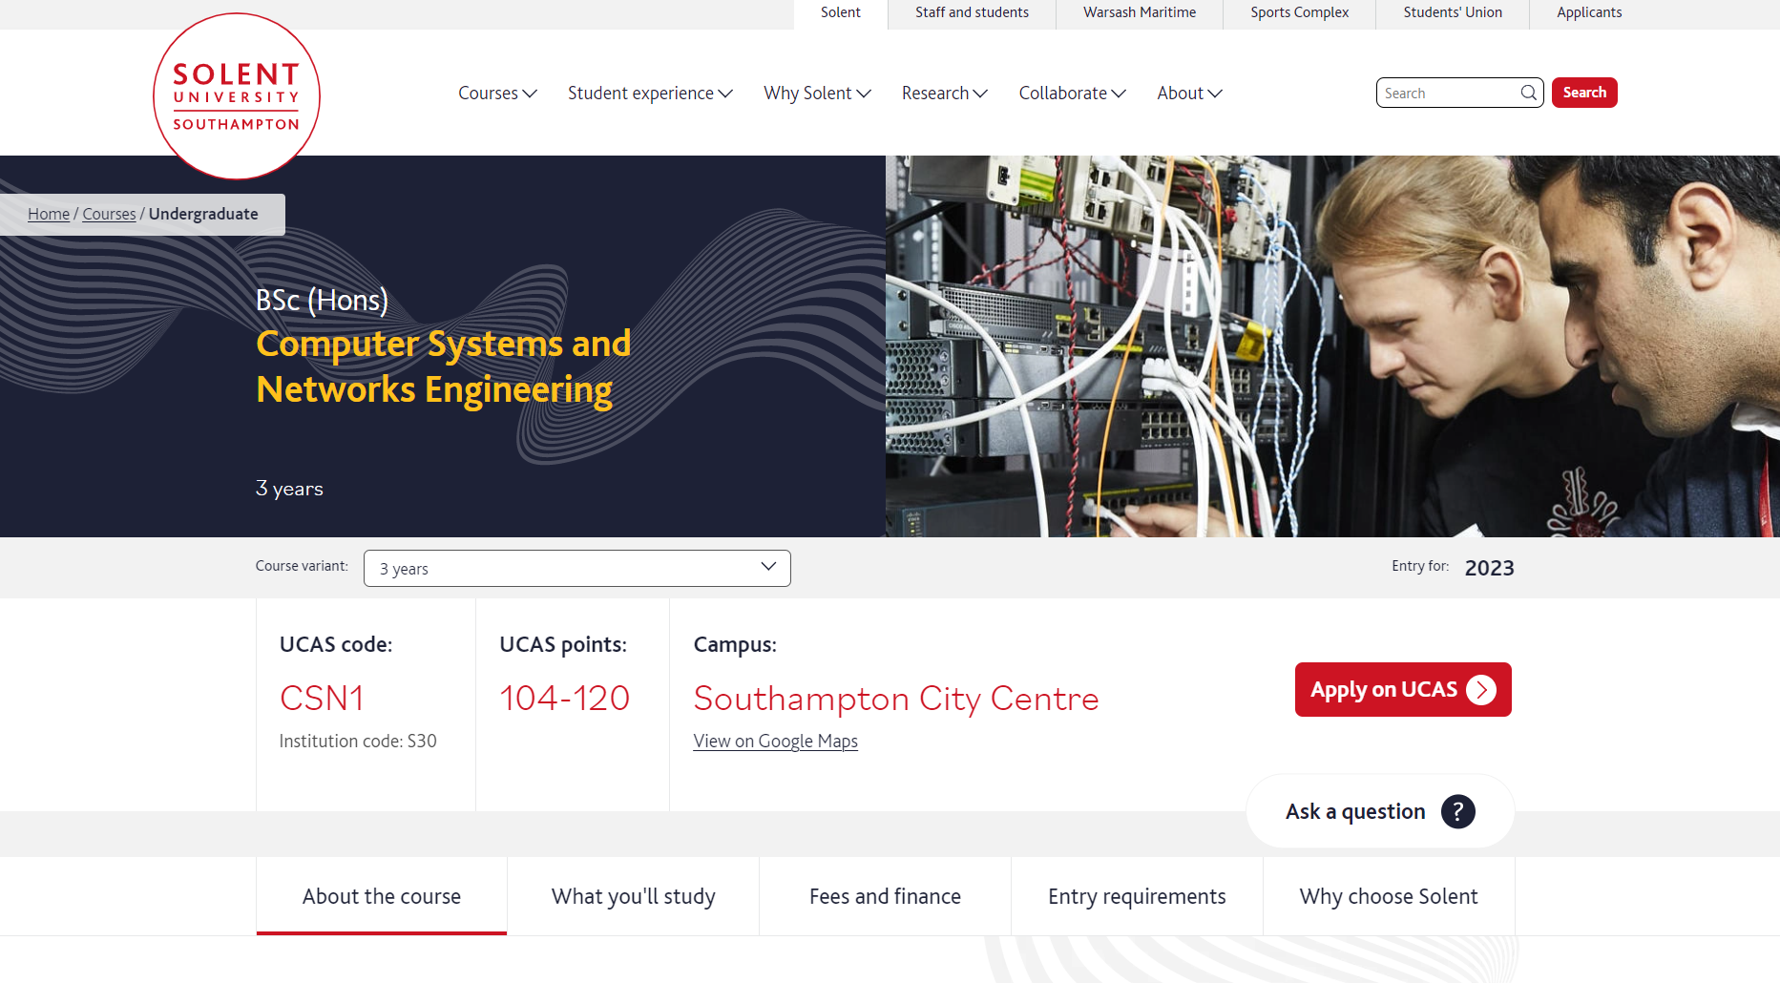
https://www.solent.ac.uk/courses/undergraduate/computer-systems-and-networks-engineering-bsc

Slide 37
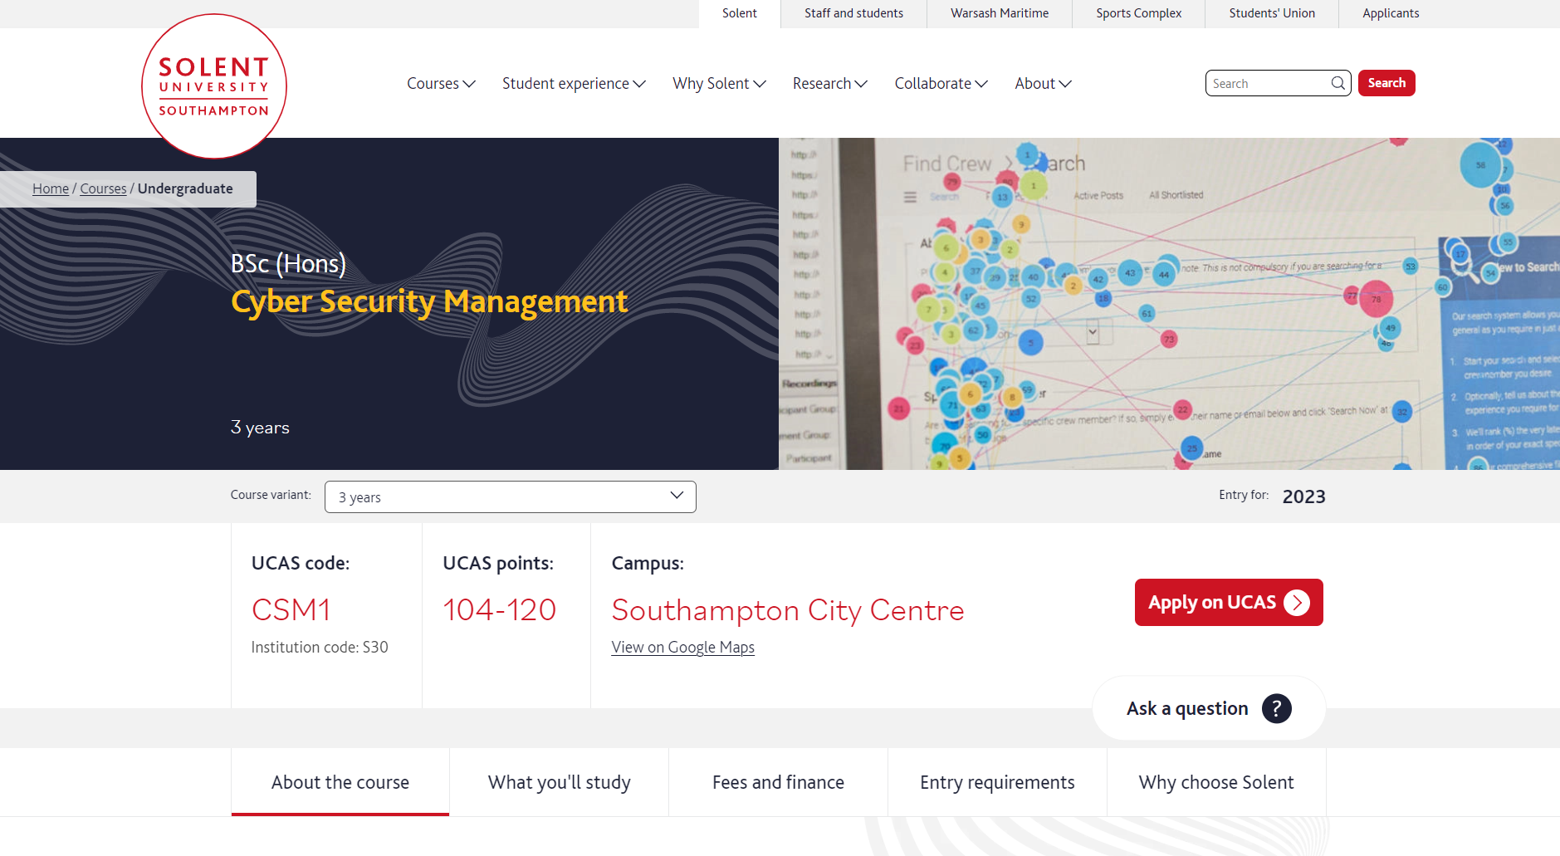
https://www.solent.ac.uk/courses/undergraduate/cyber-security-management-bsc

Slide 38

https://www.solent.ac.uk/courses/undergraduate/ug-course-hnc-data-analyst

Slide 39
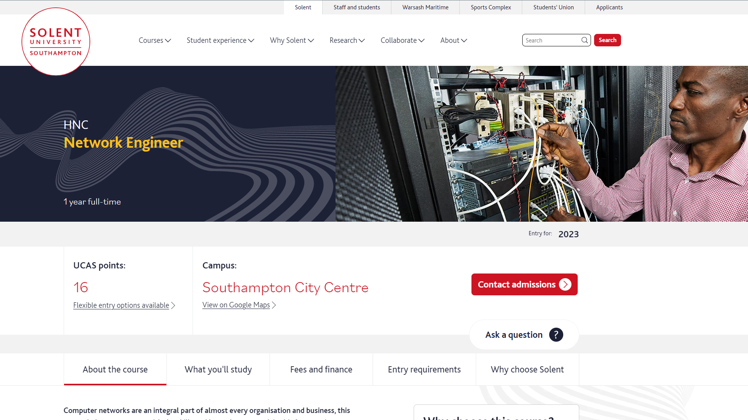
https://www.solent.ac.uk/courses/undergraduate/ug-course-hnc-network-engineer

Slide 40
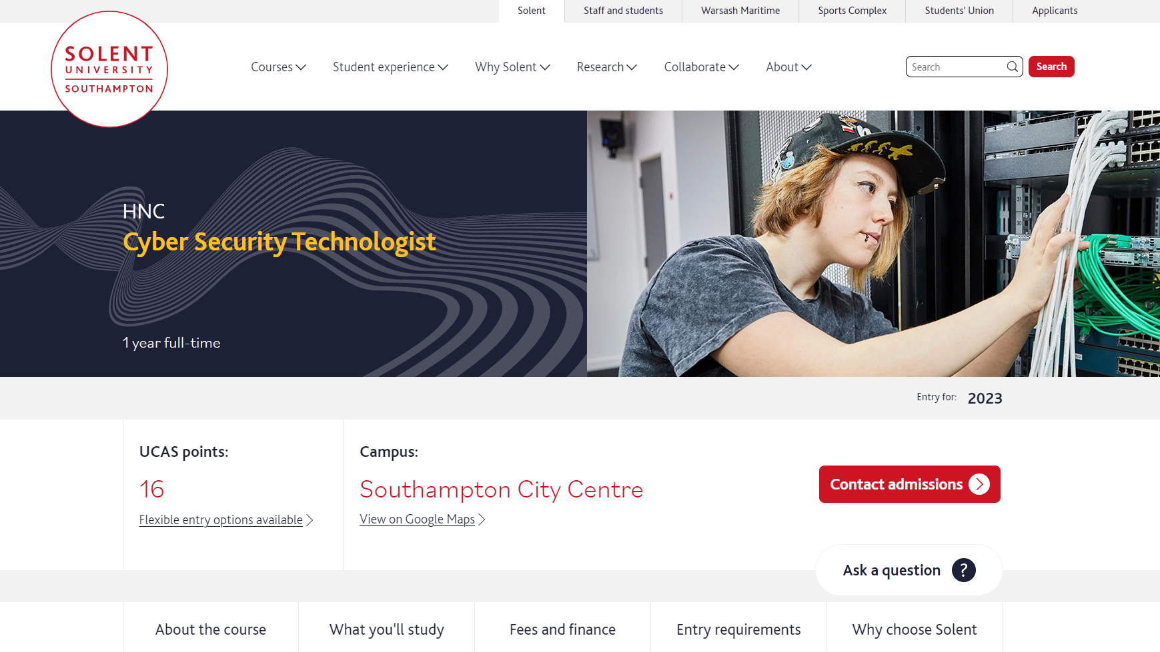
https://www.solent.ac.uk/courses/undergraduate/ug-course-hnc-cyber-security-technologist

Slide 41
Thank you
Contact
Martin Reid - Course leader for Computing Foundation martin.reid@solent.ac.uk
Drishty Sobnath- Course leader for BSc (Hons) Computing BSc (Hons) Software Engineering
drishty.sobnath@solent.ac.uk
Shakeel Ahmad - Course leader for
BSc (Hons) Cyber Security Management BSc (Hons) Computer Systems and Network Engineering
shakeel.ahmad@solent.ac.uk

